Slide 1
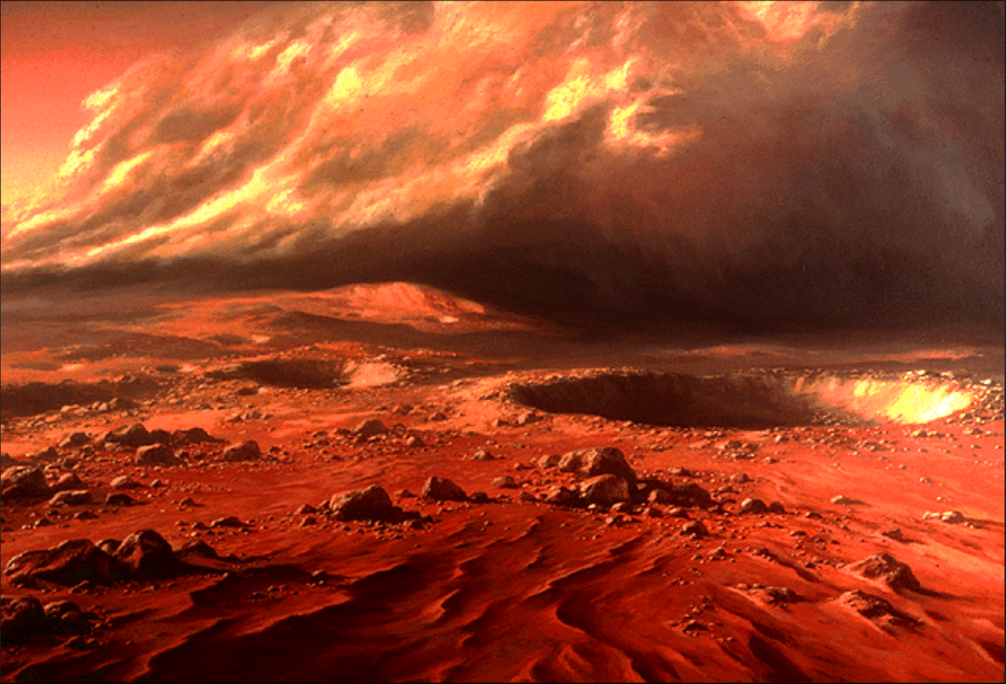
MARS Through the Dust Storm
Presented at Sperry Observatory
Friday, June 28, 2019
Clif Ashcraft

Slide 2
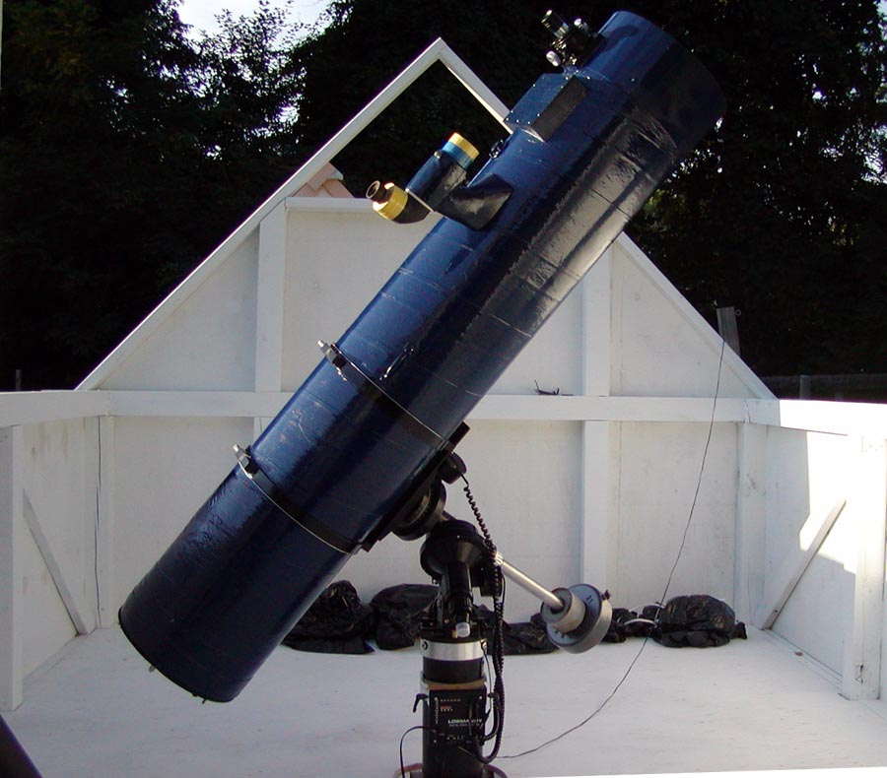
Telescopes used for Mars Imaging in this Study
The 10” f/18 Newtonian
10 inch Newtonian
7.25-inch Schupmann
C1100EdgeHD
14-inch Schmidt Cassegrain
13-inch Schupmann at MacGregor Observatory at Stellafane, Vermont

Slide 3
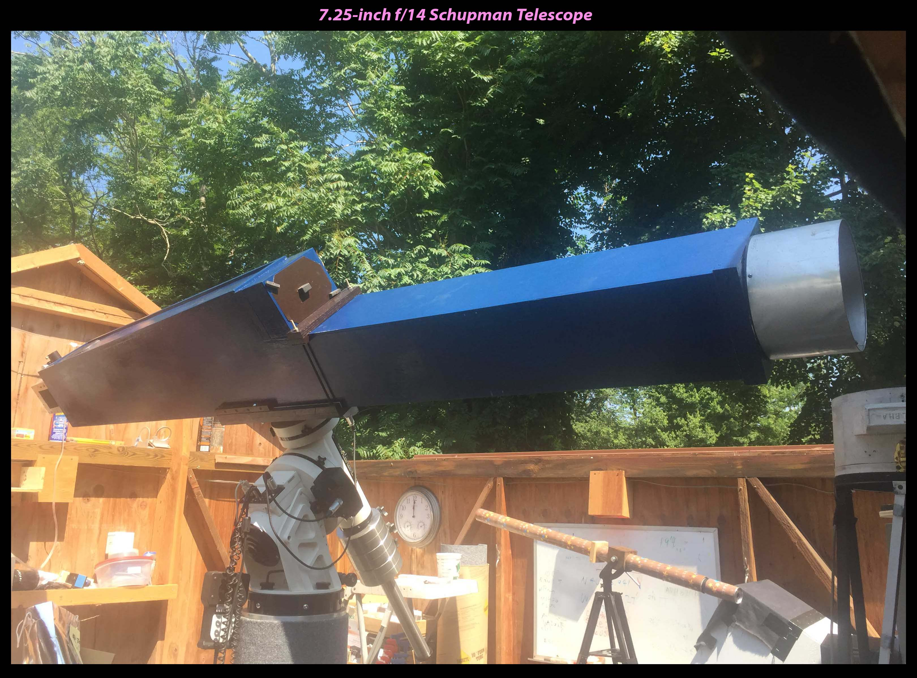

Slide 4
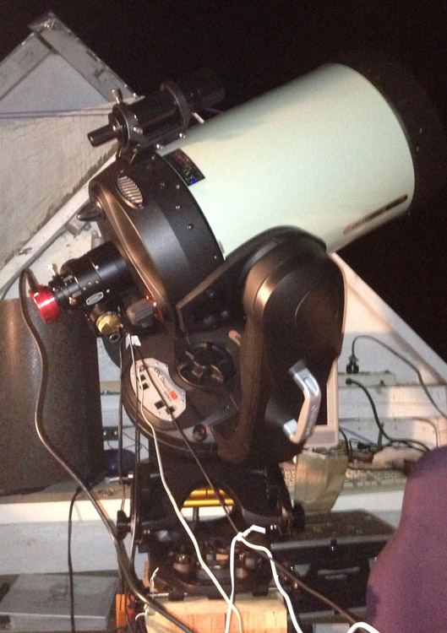
The CPC-1100EdgeHD

Slide 5
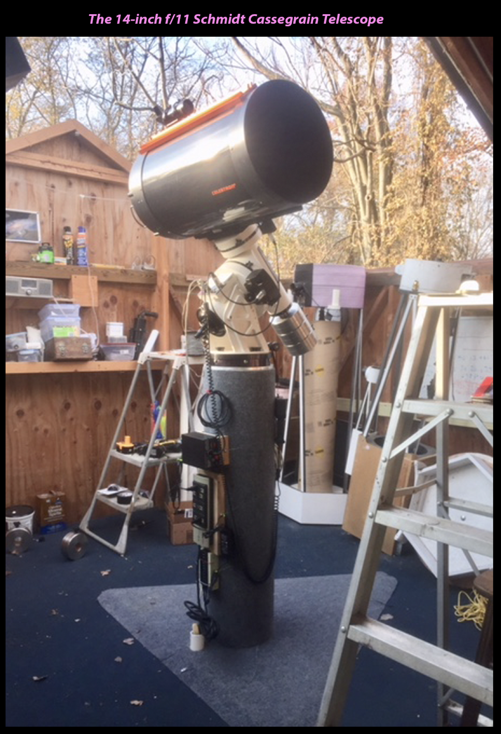

Slide 6
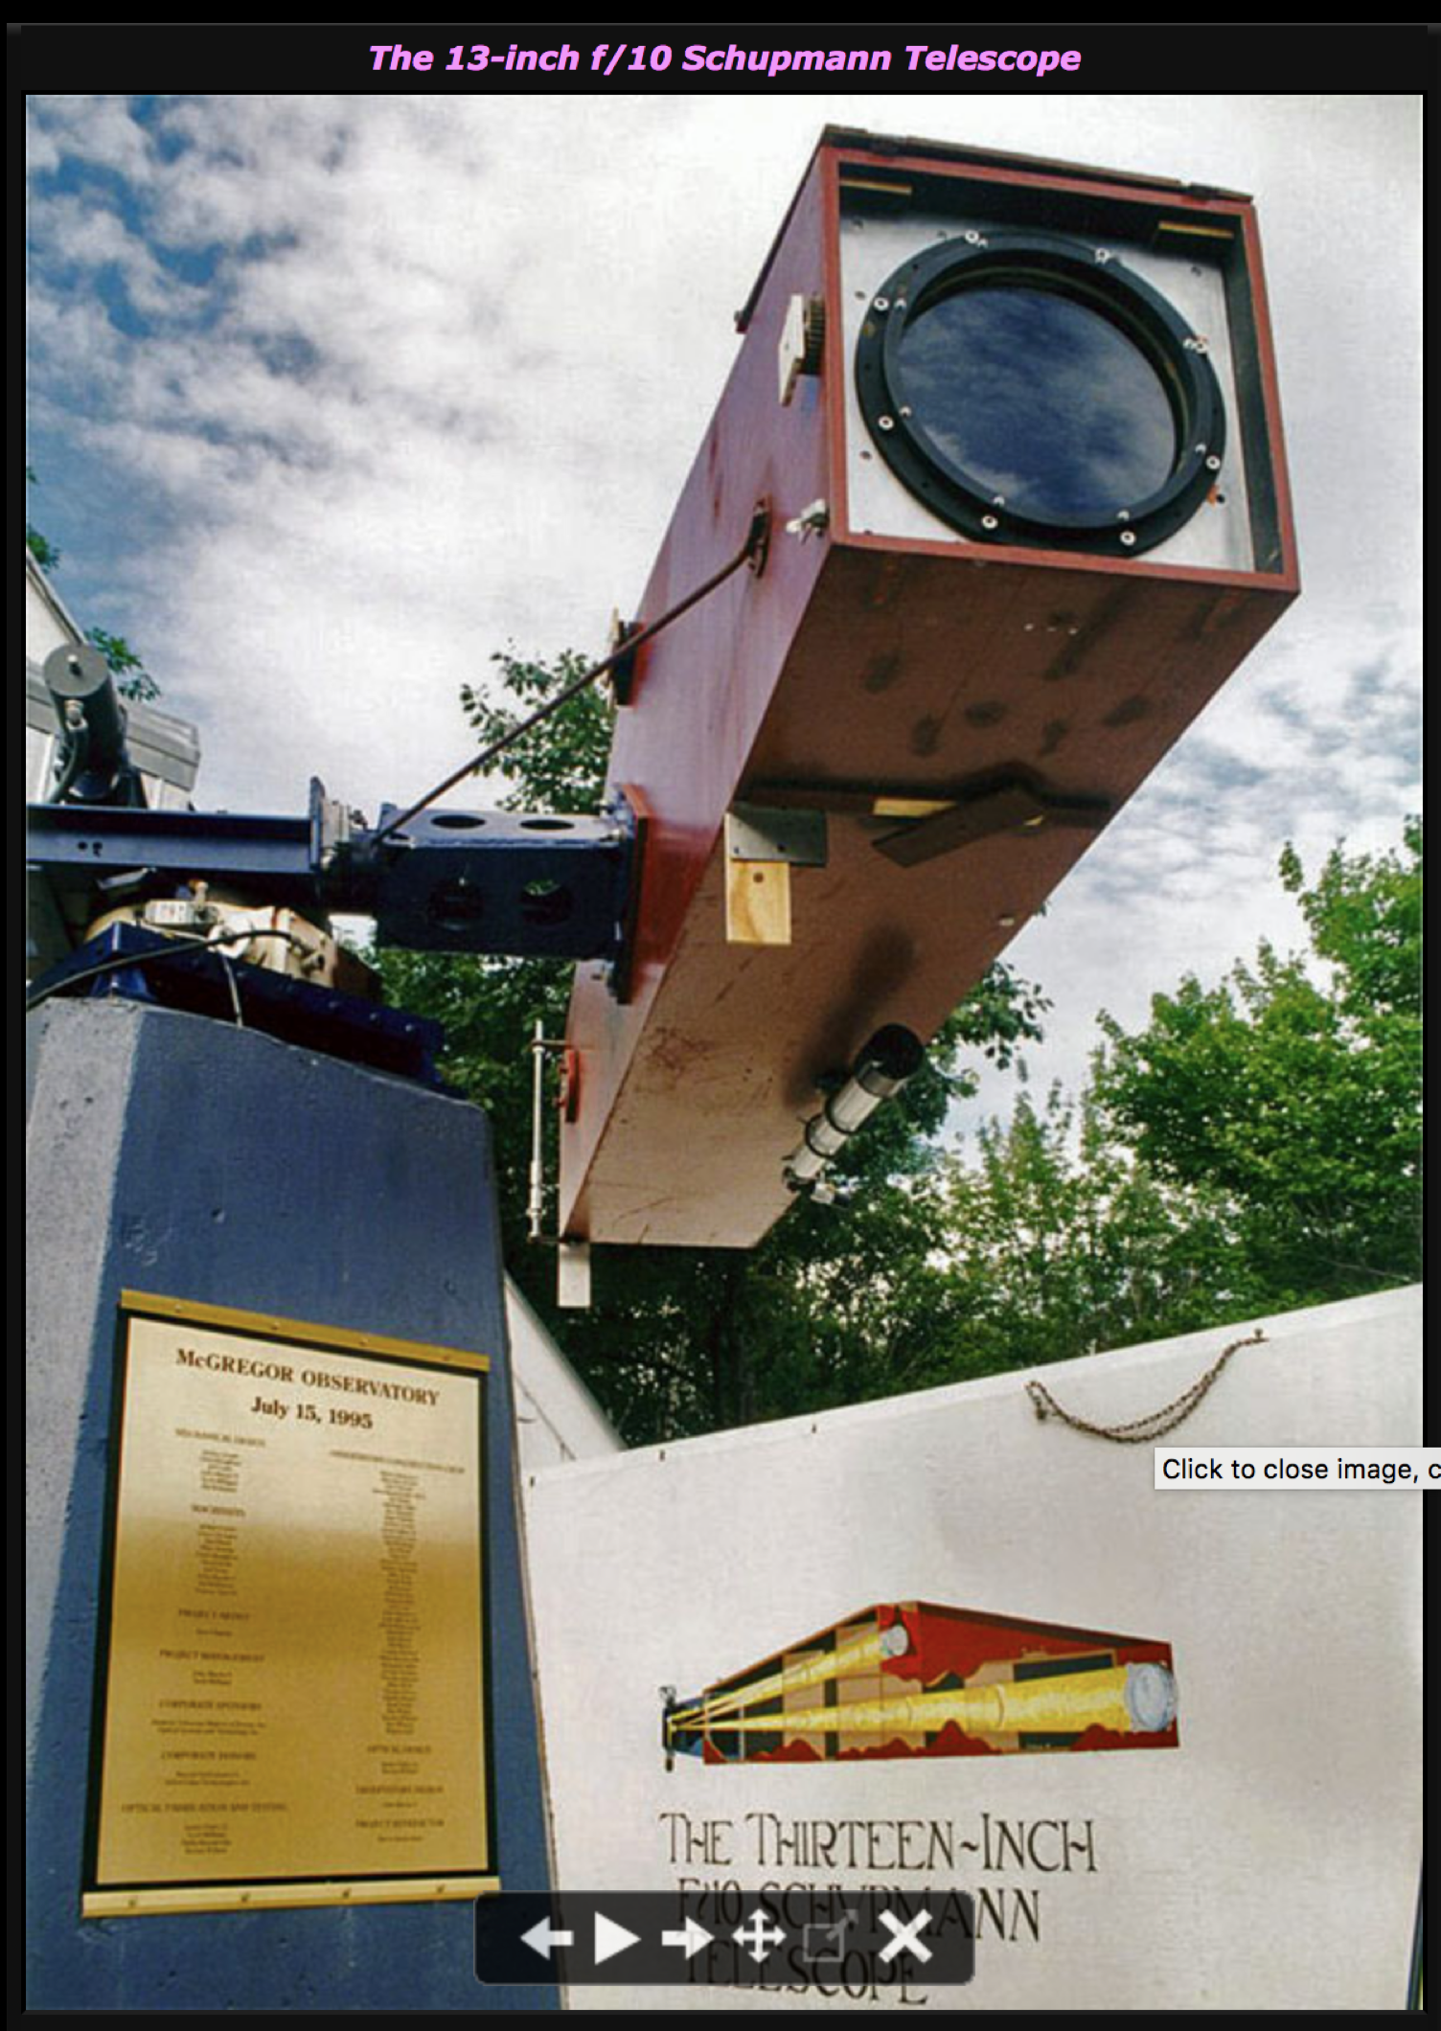

Slide 7
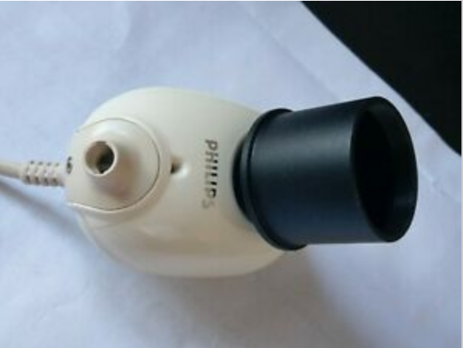
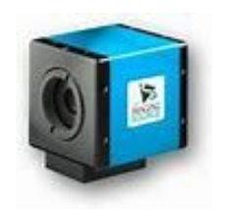
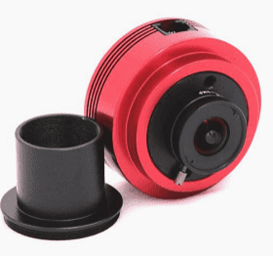
Cameras and Software
CCD Webcams
Philips ToUcam
Various Industrial Strength Webcams made by The Imaging Source, Point Grey, etc
CMOS Webcams
ZWO including ASI120MC, ASI224MC, ASI290MM
Image Capture Software --→ .avi video files of several thousand frames
Philips Driver, IC Capture, Firecapture, ASICAP
Sorting, aligning and stacking --→ creates single frame image with greatly improved s/n
- Registax, Autostakkert, WinJUPOS
Editing and composing --→ annotated images, animated GIFs
Photoshop Elements, GIMP

Slide 8
Mars Opposition, 2018
I got a late start imaging Mars this year.
Early in the opposition, the view of Mars from my observatory was obstructed by trees on my eastern horizon.
I got my first image on June 12, a month and a half before opposition.

Slide 9
The view was disappointing

Slide 10
This was in stark contrast to the clear views of the surface in the last opposition in 2016

Slide 11
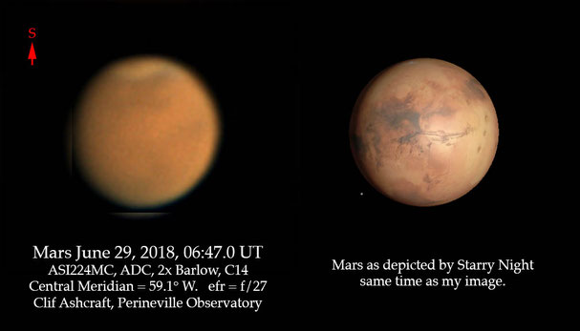
The disappointment continued through June 29, by that time the global dust storm of 2018 was in full swing and Mars was nearly featureless in visible light.

Slide 12
An animated GIF obtained the next day shows tantalizing glimpses of the South Polar Cap and vague indications of low albedo surface features.
June 30, images for animation taken with ASI224MC, 2x Barlow, atmospheric dispersion compensator and C14

Slide 13
This very disappointing
situation can be
understood by a
consideration
of the orbits of
the Earth
and
Mars:
Nearly circular, but furthest from sun about here
So, the Earth
Is closest to Mars
When Mars is closest
To the Sun.
Quite elliptical and
closest to the sun bout here

Slide 14
How does this lead to disapointment?
When Mars is at it’s closest, and the possibilities for viewing and imaging Mars ought to be the best, you are most likely to encounter a dust storm for these reasons:
It is summertime in the Southern Hemisphere on Mars which is tilted towards Earth
Surface temperatures can easily get over the triple point of water of 0.01°C/4.58 mm, and in fact can get over 70°F
Under these conditions, ice crystals in the soil can vaporize directly to water vapor
Thermal plumes of humid air rise and condense at cooler altitudes
Condensation releases heat energy, driving storm winds, just like on earth
Dust devils and storm winds fill the atmosphere with dust and friction creates static charge and lightning strikes.
Entire planet may be obscured
No surface features are visible
Amateur astronomers are disappointed
Matt Damon gets left behind

Slide 15
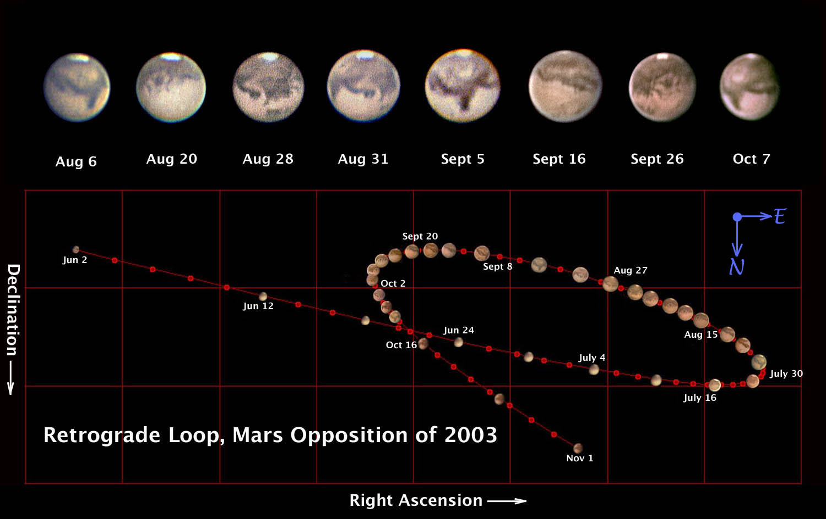
It doesn’t always happen: In 2003 we got lucky, no global dust storm
Images taken with Philips ToUcam on 10”, f/6 Newtonian, f/46.5

Slide 16
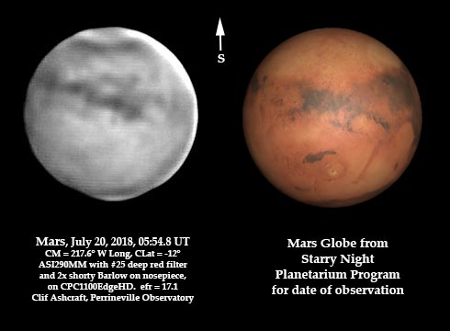
What to do?
Short wavelengths are more strongly scattered by dust particles
So, maybe use a long pass filter to cut off short wavelengths?
Yellow or orange filters help visual observing if the dust is not too dense
Deep red filters might help with CMOS cameras, but not for visual observation, just too dark.
Here is an image I got on July 20 with a #25 deep red Wratten filter on my ASI290MM camera, 2x Barlow and the CPC1100EdgeHD.

Slide 17
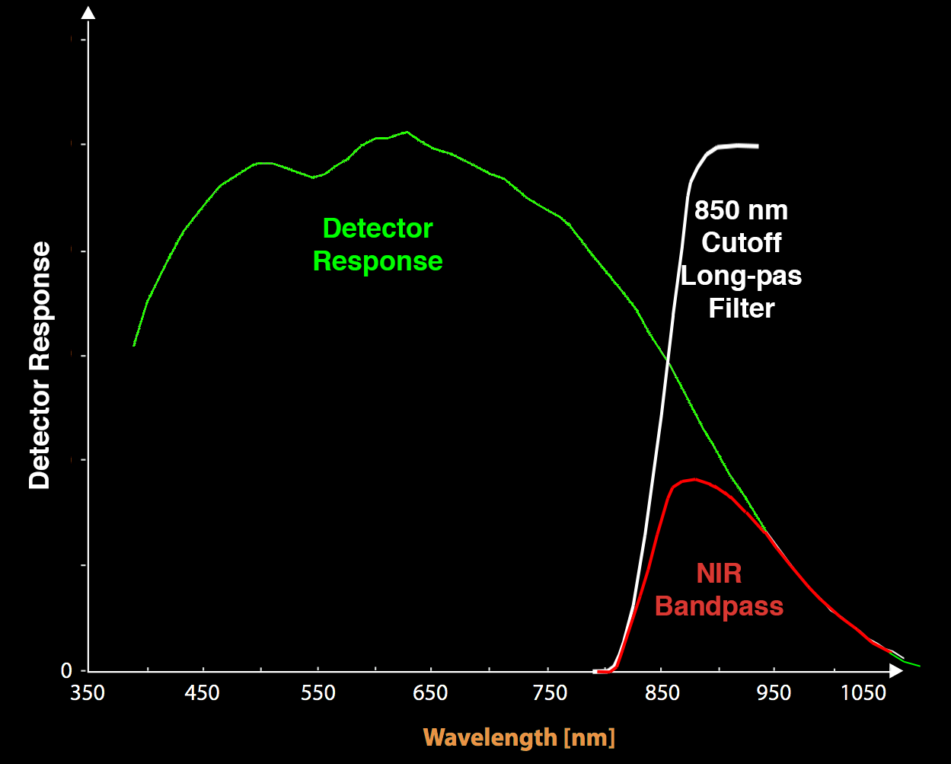
How about Infrared?
I ordered a ZWO 850 nm cutoff long pass filter from Highpoint.
Combined with a silicon detector, this filter should give a bandpass of about 800 – 1000 nm in the NIR.
The filter arrived just in time to take it to Stellafane.
Tom Spirock, Mark Sproul and I tried it at MacGregor with the 13” Schupmann on Sunday evening, August 5.
Results were impressive…

Slide 18
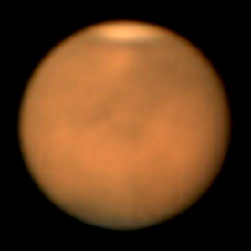
CM = 50.2
CM = 32.6
RGB Image taken with Tom’s ASI120MC and a 9” stop on the big Schupmann, efr = 14.4
Contrast pushed to the Max
IR Image taken with my ASI290MM
fitted with the 850 nm long pass filter, same 9” stop on the Schupmann, efr = 14.4

Slide 19
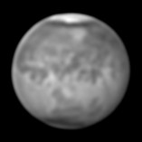
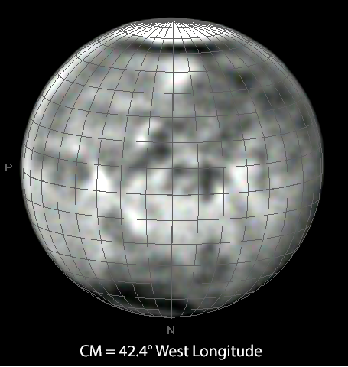
With Latitude/Longitude grid added using WinJUPOS:

Slide 20
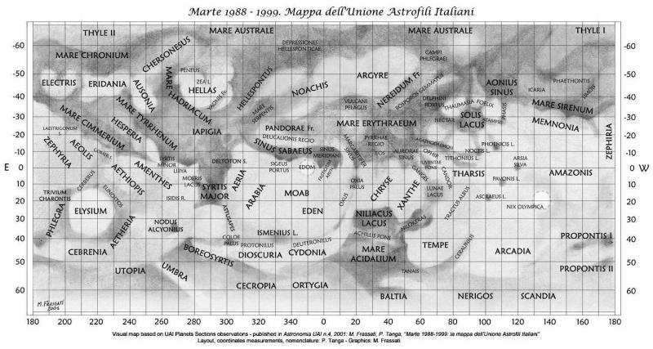
And a good Mars Map:

Slide 21
We can identify a bunch of known surface features:
South
Polar cap
Mare
Australis
Argyre
Impact basin
Storm activity in
Mare Erythraeum
Solis Lacus
Valis
Marineris
Sinus
Sabaeus
Sinus
Meridiani
(Opportunity)
Margaritifer
Sinus
Mare
Acidalium
Niliacus
Lacus
North
Polar cap

Slide 22
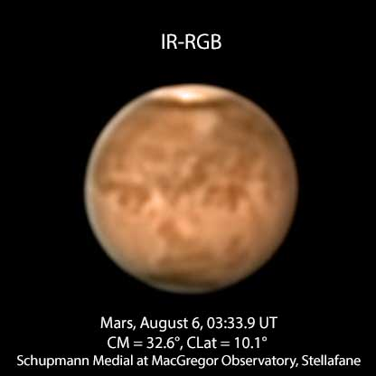

Slide 23
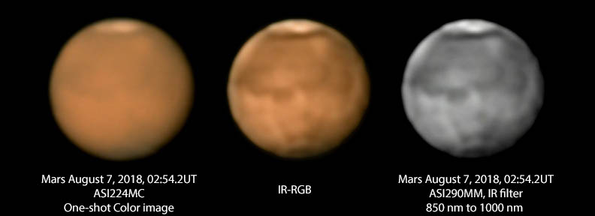
CM = 14.2°
The next evening the seeing was not quite so good, but we got this image showing features a bit further east:
No further imaging opportunities at MacGregor, clouds prevailed with occasional clearings, lots of visitors wanting to look through the big Schupmann

Slide 24
When I returned home from Stellafane, I continued to use the 850 nm long pass filter
Although the dust storm was still in full blast, the view on August 16 at home with my 7.25” Schupmann showed a fine view of Syrtis Major and the Hellas impact basin.
Note that dust has covered some of the west side of Syrtis Major.

Slide 25
On August 24, seeing was pretty good

Slide 26
Movement of dust storm fronts and unexpected visibility of Gale Crater

Slide 27
Two days later, movement of the storm fronts becomes apparent.
Animated GIF from images of Aug 24 and 26
Movement is about 70 miles per day.

Slide 28
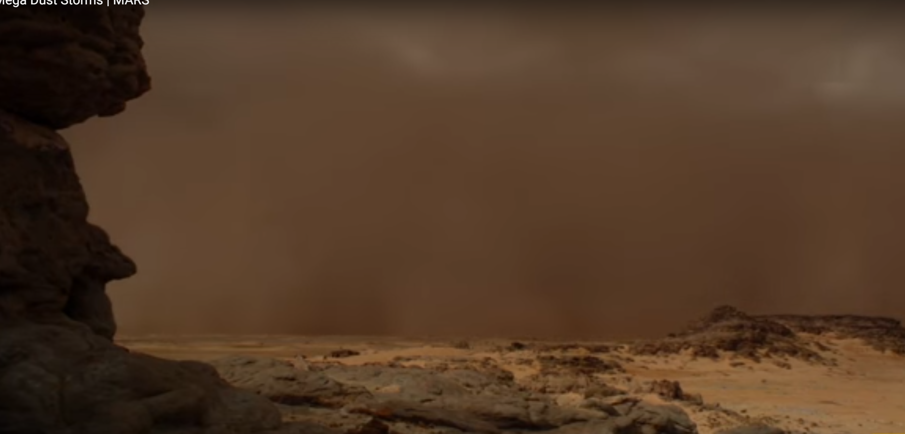
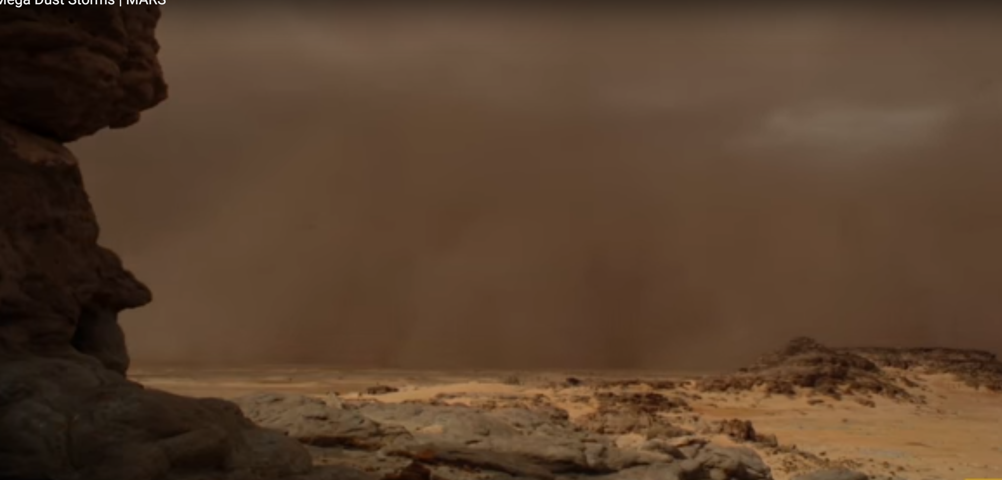
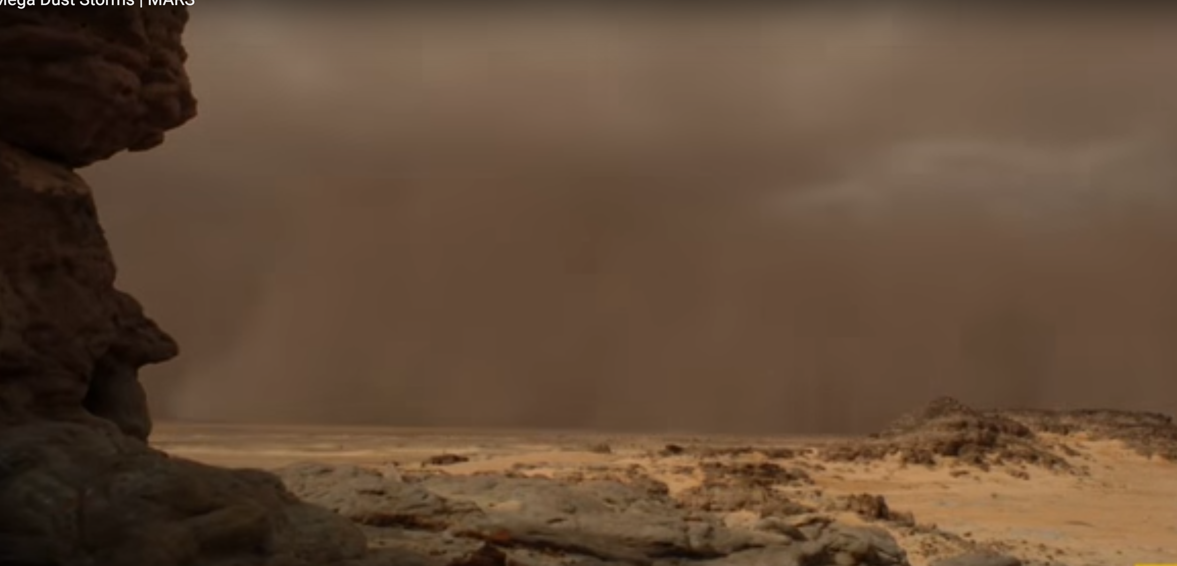
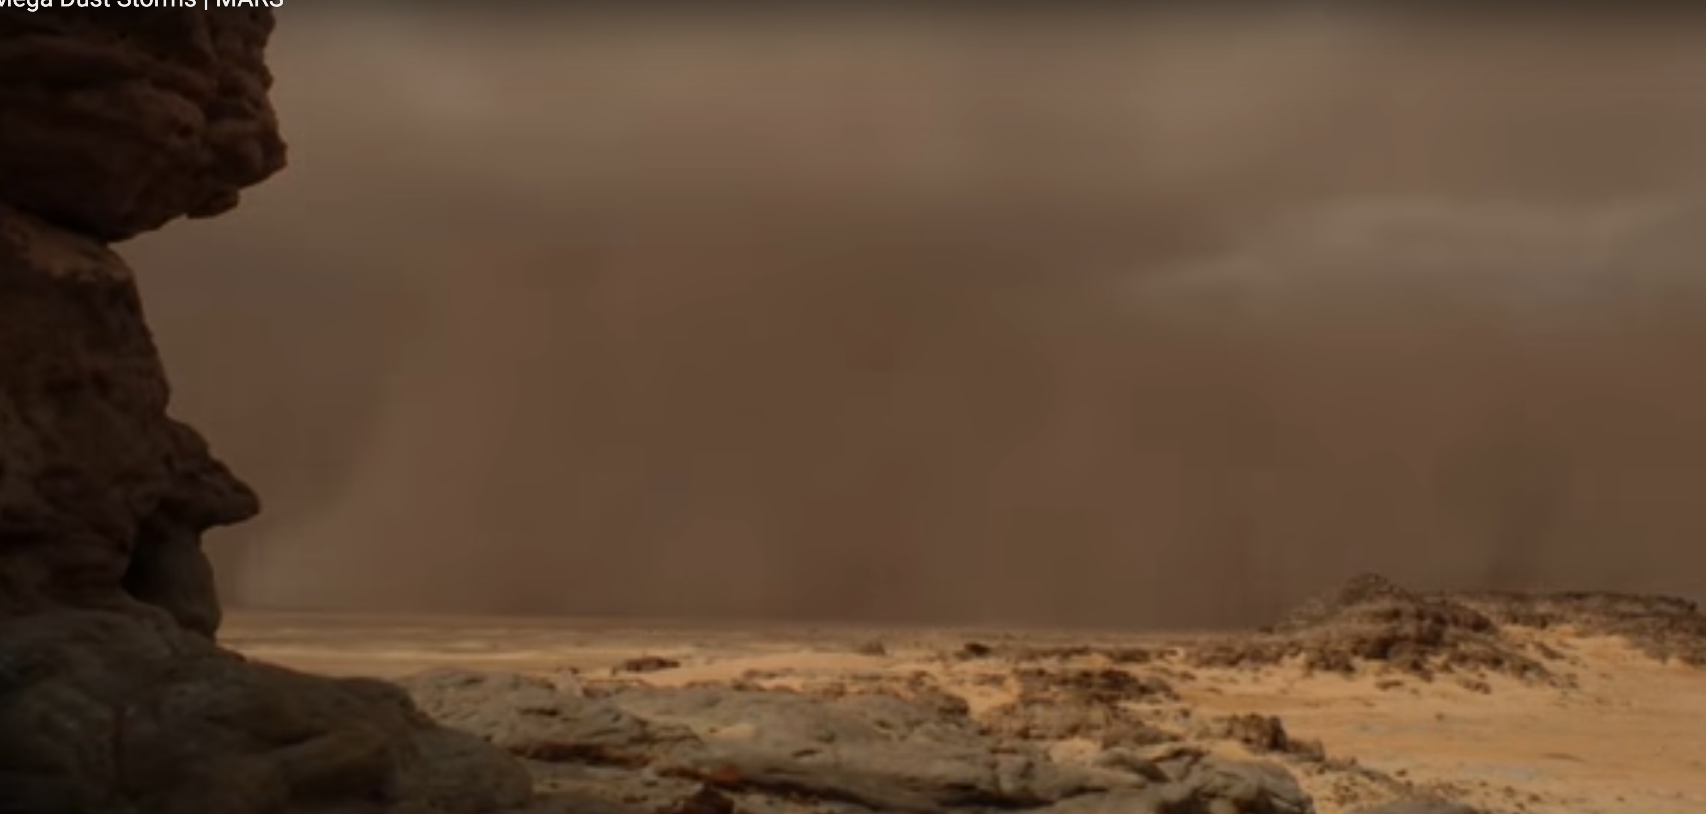
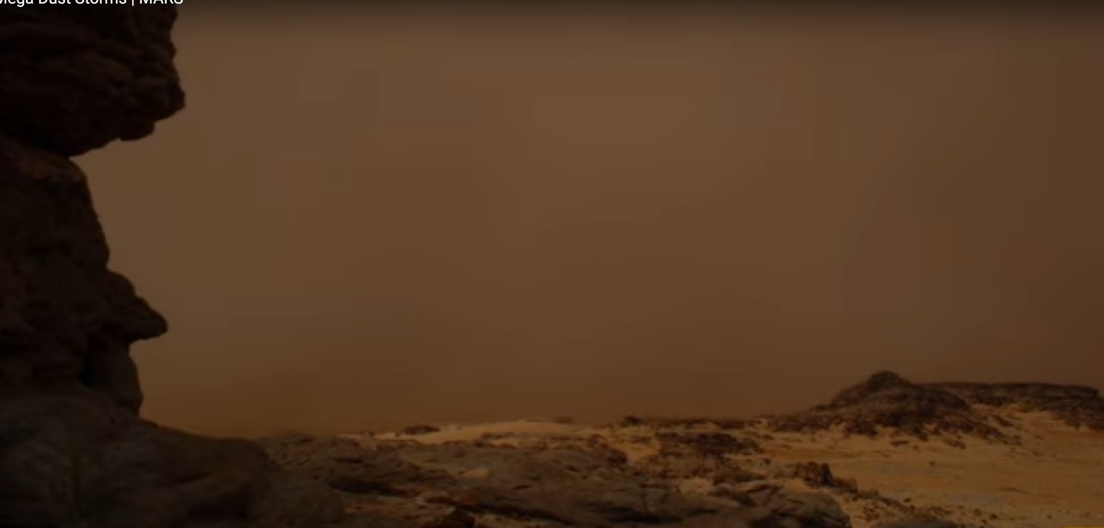
Imagine being in the path of such a storm front!
But you would be in no danger of blowing away, at 5 mm atmospheric pressure, hurricane force winds would feel like a gentle breeze.
Microwaves generated from electrical discharge have been observed during
a dust storm on Mars by researchers at AOSS (Atmospheric, Oceanic & Space Science).
Nobody has heard the thunder though. Maybe InSight will hear some…

Slide 29
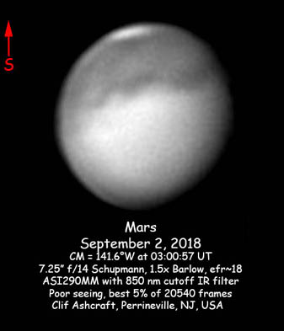

Slide 30
A bit of clearing early in September

Slide 33
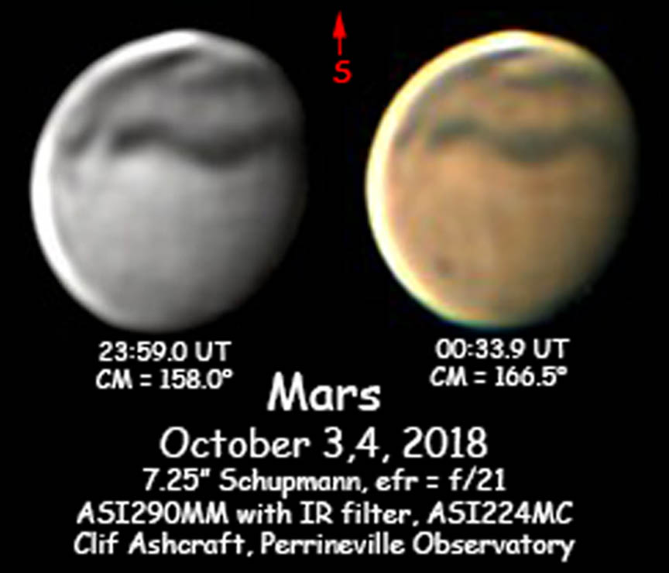
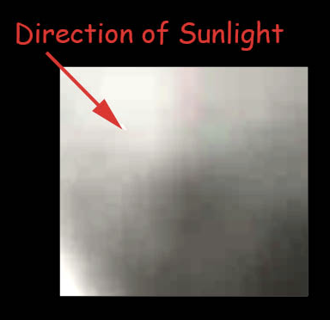
Olympus Mons Through the Dust Although the surface is still mostly obscured, by October 4 the summit of Olympus Mons can be seen above the thinning dust storm.
The volcano has a height of nearly 22 km
(13.6 mi or 72,000 ft)

Slide 36
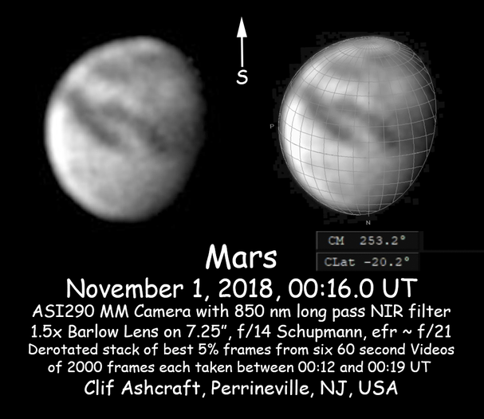
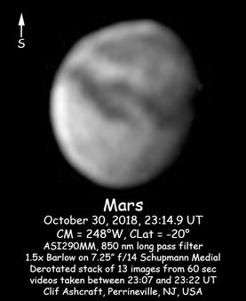

Slide 38
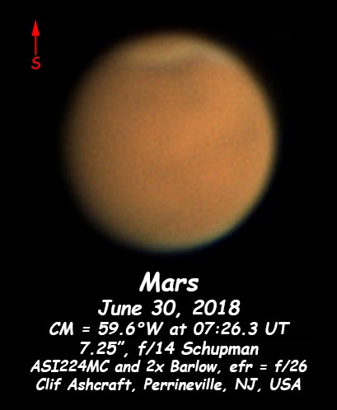
Clearing continues…
11”

Slide 39
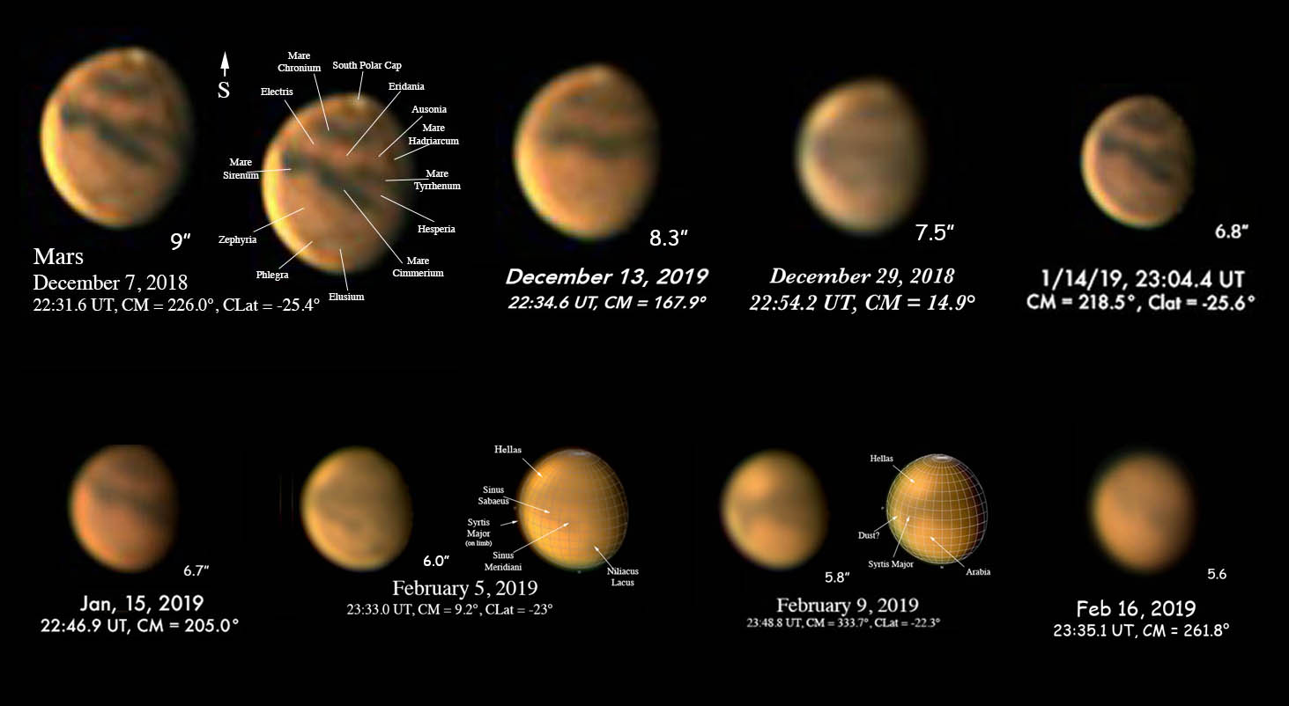
The rest of the Opposition Until I lost Mars in the Evening Twilight

Slide 40
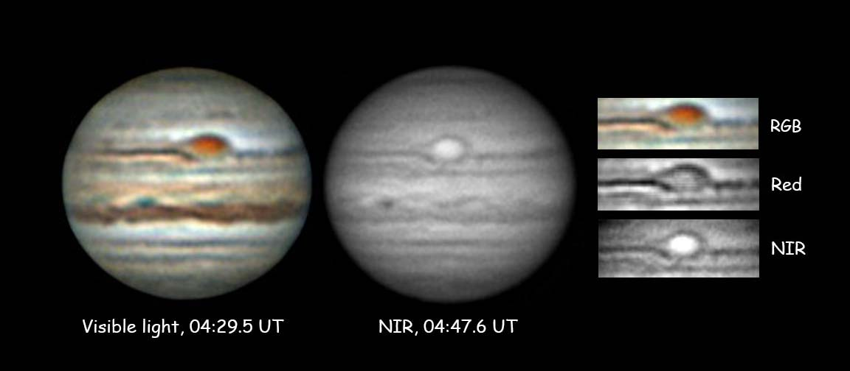
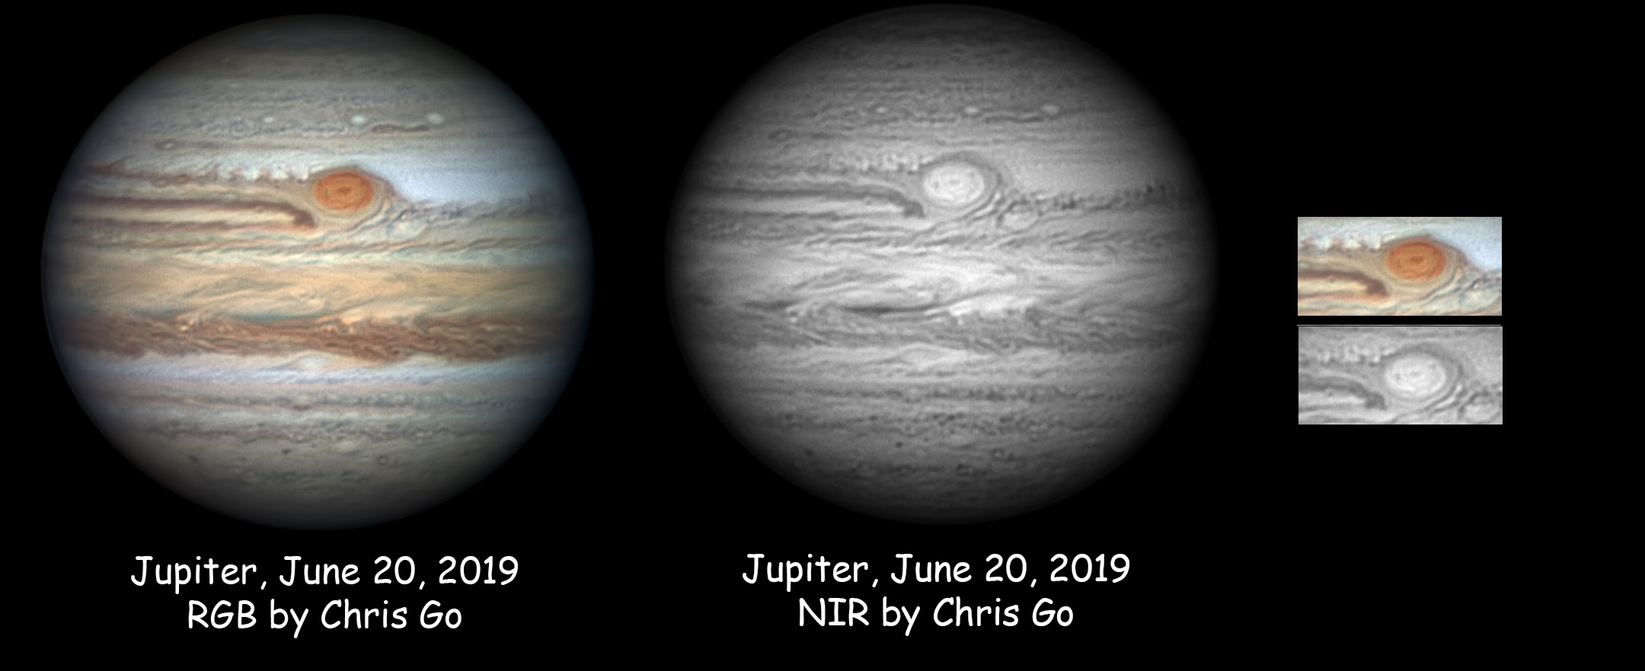
Other interesting NIR Applications
3.5”

Slide 41
Questions?

